Slide 1
Non-Functinal Testing Types
Software Testing

Slide 2
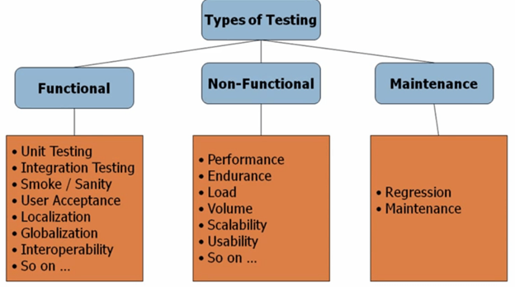
Types of testing

Slide 3
Non-functional Testing
Non-functional testing is done to verify the non-functional requirement of the application like Performance, Usability, etc.
It covers all the aspects which are not covered in functional testing
An application is developed and is completely tested for functionality, but non- functional testing is not performed on the same.
Meanwhile, when the application goes live, it might result in critical or major issues like when the load is increased on the application, it becomes too slow and takes a lot of time to open.

Slide 4
Advantages
It covers the testing which cannot be covered in functional testing.
It ensures that the application runs efficiently and is reliable enough.
It ensures the security of the application.

Slide 5
Performance Testing:
Validates that the system meets the expected response time.
Evaluates that the significant elements of the application meet the desired response time.
It can also be conducted as a part of integration testing and system testin

Slide 6
Load Testing
Validates that the system performs as expected when concurrent users access the application and get the expected response time.
This test is repeated with multiple users to get the response time and throughput.
At the time of testing, the database should be realistic.
The test should be conducted on a dedicated server which stimulates the actual environment

Slide 7
Instability Testing:
Validates that the system components are installed correctly on the designated hardware.
Validates that the navigation on the new machine updates the existing installation and older versions.
Validates that with insufficient disc space, there is no unacceptable behavior.

Slide 8
Recovery Testing:
Power interruption, to the client while doing CURD activities.
Invalid database-pointers and keys.
Database process is aborted or prematurely terminated.
Database pointers, fields and keys are corrupted manually and directly within the database.
Physically disconnect the communication, power turn off, turn down the routers and network servers.

Slide 9
Security Testing:
Security testing is done to ensure that the application has no loopholes which could lead to any data loss or threats. It is one of the important aspects of non-functional testing and if not performed properly, it can lead to security threats.
It includes testing authentication, authorization, integrity, and availability.

Slide 10
Other Types
Disaster Recovery Testing:
This testing is done to verify the success rate of recovery of an application or system if any critical failure happens and whether the system is able to restore the data and application or the system could cope up easily to return the way it was working earlier i.e. from the operational front.
Maintainability Testing:
Once the application/Product goes live, then there are chances for an issue to come up in the live environment or the customer may want an enhancement for the application which is already live.
In this case, maintenance testing team is available to test the above scenarios mentioned. Once the application goes live it still needs maintenance for which the maintenance testing team works.

Slide 11
Other Types
Reliability Testing:
Reliability testing is done to verify if the application is reliable and is tested for a specific period of time in the defined environment. An application should give the same output as expected every time, only then it can be considered as reliable.
Portability Testing:
Portability testing is done to verify if in case a software/application is installed on a different system or on a different platform it should be able to run as expected i.e. no functionality should be affected because of a change in the environment.

Slide 12
Other Types
Endurance Testing:
Endurance Testing is done to verify the system's behavior when a load is increased to an extent for a long time.
It is also called as Soak testing & Capacity testing. It helps to verify if there are any memory leaks in the system. Endurance testing is a subset of load testing.
Localization Testing:
Localization testing is done to verify the application in different languages i.e. different locales. The application should be verified for a particular culture or locale. The main focus is to test the content, GUI of the application.

Slide 13
Non-Functional Test Tools
JMeter
Loadster
Loadrunner
Loadstorm
Neoload

